Slide 1
MAMC01801 Capabilities for Managers
Week 6 - The Cultural Paradigm

Slide 2
Agenda
Internal culture and its impact on organisational performance
The ASB matrix
Notes:
2

Slide 3
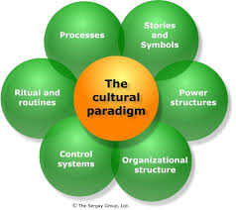
The Cultural Paradigm
Notes:
3

Slide 4
Structure, power and process When you look at a company, ask yourself the following questions:
Organisational structure: Is the company hierarchical or organic, bureaucratic or democratic. Are job roles and descriptions clearly defined or ambiguous?
Power structures: Are all decisions made by top management, or is authority pushed down to lower seniority levels? Is spending tightly controlled, or minimally monitored? Who can make a decision to spend money, hire staff, implement strategies?
Internal processes: What do those processes look like, are they carried out in-house or outsourced, to what extent do they operate independently or interlink with each other?
Notes:
4

Slide 5
Stories, rituals and control systems
What stories and symbols exist? Do employees dress in formal business wear or in jeans and tee-shirt? Is there a respected and charismatic founder; how important is organisational heritage?
What rituals and routines exist? Is the company song routinely sung, is there an “every Monday at 8:30” type of get together of all staff? Are rest breaks strictly observed, or do people eat and drink “on the run”? Does the organisation slow down its pace to accommodate Friday afternoon drinks?
What internal control systems exist? Does management monitor clock-in and clock-out times; do employees wear ID badges and get regular security checks; are employee activities routinely subjected to audit by a more senior staff member? Or does the organisation allow employees to manage their own work behaviour in their own chosen way?
Notes:
5

Slide 6
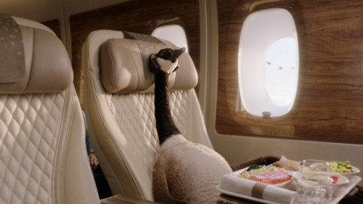

How would these organisations look like if we applied the cultural model?
Air New Zealand https://www.youtube.com/watch?v=qOw44VFNk8Y
Emirates
https://www.youtube.com/watch?v=5lGRtUA9Mds
Notes:
6

Slide 7
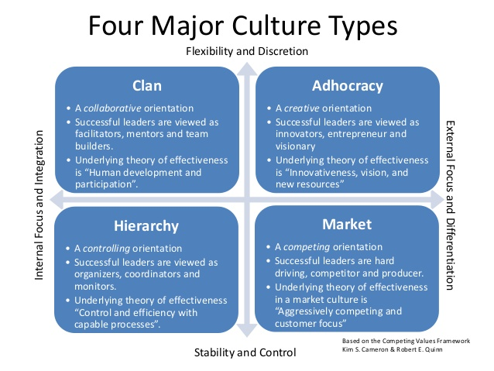
COMPETING VALUES MODEL
Notes:
7

Slide 8
What’s driving the company culture?
The Clan: The needs of the organisation’s employees
The Market: The needs of the organisation’s customers
The Hierarchy: The effects of systems and processes
The Adhocracy: A need to continuously “do things differently”
Notes:
8

Slide 9
Shopping homework
Students will present the findings on culture from the shopping expeditions they began in Week 3.

Slide 10
Exercise. Marking a sample of assignment 2
Please read the samples of the second assignment on the assessment page and mark them using the rubric.
You will be asked to share your findings with the class.

Slide 11
Assessment Two Draft
Individual work
Your draft must include a table that you briefly identify:
Two capabilities for the PD. Identify the different aspects of the capabilities and their examples within the KML project.
Three Māori values in the KML project. Identify the 3 values, their different aspects and examples within the KML project
Two potential CSR issues and how these meet the stakeholders’ expectations. Also identify the stakeholders and their expectations, all within the KML project.

